Slide 1
Protocol Layering
Protocol layering allows us to divide a complex task into several smaller and simpler tasks
A layer (module) is a black box with inputs and outputs without concerns about the conversion of inputs to outputs
A layer needs to be able to receive a set of services from the lower layer and to give the services to the upper layer
  We do not care about how the layer is implemented
There are also intermediate systems other than end-systems used by communication with respect to protocol layering in the Internet

Slide 2
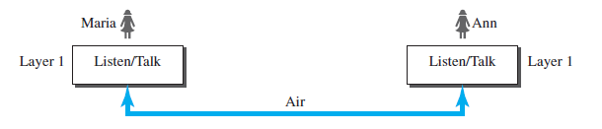
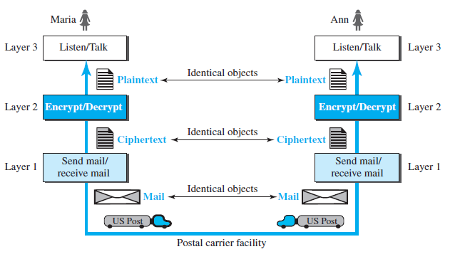
Protocol Layering
A simples scenario (only 1 layer)
A bit complex scenario (many layers)

Slide 3
Principles of Protocol layering
First principle
For bidirectional communication: Each layer should be able to perform two opposite tasks
  3rd layer task is to talk (in one direction) and listen (in other direction)
  2nd layer encrypt (on one side) and decrypt (other side)
  1st layer, send and receive email

Slide 4
Principles of Protocol layering
Second principle
Two objects under each layer at both sides should be identical
  Objects under layer 3 : plain text
  Objects under layer 2: Cipher text
  Objects under layer 1: a piece of mail

Slide 5
Models of Layers
Principals Create a layer where a different abstraction is needed
Each layer should perform a well-defined function
The function of each layer should be chosen
  With target for standardization
Minimize information flow across layer boundaries
Number of layers
  Large: distinct functions are not in the same layer
  Small : architecture does not become complex

Slide 6
INTERFACE BETWEEN LAYERS
The passing of the data and network information down through the layers of the sending device and back up through the layers of the receiving device is made possible by an interface between each pair of adjacent layers.
Each interface defines the information and services a layer must provide for the layer above it.
Well-defined interfaces and layer functions provide modularity to a network.

Slide 7
Reference Models
Layers model
A theoretical approach describing how data is going to be transmit over the network
The TCP/IP Protocol Suit
  Used in all WANs, the ARPANET, worldwide Internet
The OSI Reference Model (minus physical medium)

Slide 8
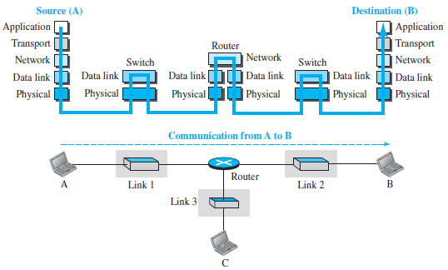
TCP/IP Layered Architecture
Consider a small internet of three LANs (each with a link layer switch).
Further, assume that links are connected by one router

Slide 9
TCP/IP Layered Architecture
The two hosts are involved in all five layers
Source host creates a message in the application layer and sends it down the layer for physical delivery to the destination host
Destination host receives the communication at physical and then deliver to the application layer through other layers
Router is involved three layers
  Involved in only one network layer; but involved in n (number of links) combinations of link and physical layers
  Each link may use its own data link and physical protocol
Link layer switch is involved in only two layers
  It is involved only in one data-link and one physical layer

Slide 10
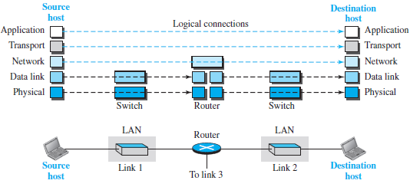
LAYERS IN THE TCP/IP Protocol Suit (Book2:2.2.2)
Logical connections make easier to think about the duty of each layer.
The duty of the application, transport, and network layers is end-to-end (so domain is internet).
However, the duty of the data-link and physical layers is hop-to-hop, a hop being a host or router (domain is link).

Slide 11
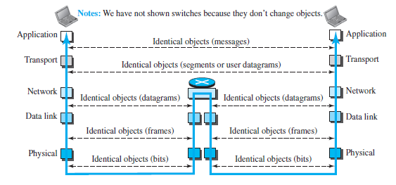
LAYERS IN THE TCP/IP Protocol Suit
Logical connections may be thought of as data unit created at each layer, a hop being a host or router.
In top three layers
  Data unit (packets) should not be changed by any router or link-layer switch.
In the bottom two layers,
  the packet created by the host is changed only by the routers, not by the link-layer switches.

Slide 12
Description of Layers

Slide 13
PHYSICAL LAYER IN THE TCP/IP
responsible for carrying individual bits in a frame across the link.
Transmission medium does not carry bits; it carries electrical or optical signals.
So the bits received in a frame from the data-link layer are transformed and sent through the transmission media,
  but we can think that the logical unit between two physical layers in two devices is a bit.
There are several protocols that transform a bit to a signal.

Slide 14
DATA-LINK LAYER IN THE TCP/IP (1)
Several overlapping sets of links for datagram to travel from source to the destination.
  The routers are responsible for choosing the best links.
When the next link to travel is determined by the router,
  the data-link layer takes datagram and moves across the link.
The link can be a wired LAN with a link-layer switch, a wireless LAN, a wired WAN, or a wireless WAN.
In each case, the data-link layer is responsible for moving the packet (frame) through the link.

Slide 15
DATA-LINK LAYER IN THE TCP/IP (2)
The data-link layer takes a datagram and encapsulates it in a packet called a frame.
Each link-layer protocol may provide a different service.
  Some link-layer protocols provide complete error detection and correction,
  some provide only error correction.

Slide 16

Hop-to-hop delivery

Slide 17
NETWORK LAYER IN THE TCP/IP (1)
Responsible for creating a connection between the source and the destination.
The communication at the network layer is host-to-host.
Routers in the path are responsible for choosing the best route for each packet.
So, network layer is responsible for host-to-host communication and routing the packet through possible routes.
In the Internet, it includes the main protocol, Internet Protocol (IP), that defines
  the format of the packet, called a datagram at the network layer.
  the format and the structure of addresses used in this layer.

Slide 18
NETWORK LAYER IN THE TCP/IP (3)
IP is also responsible for routing a packet from its source to its destination,
  achieved by each router forwarding the datagram to the next router in its path.
It includes unicast and multicast routing protocols
Routing is duty of IP (not of routing protocol)
Routing protocol helps routers in routing process
  By creating forward tables for routers

Slide 19

Source-to-destination delivery

Slide 20
Transport Layer (Layer 4)
UDP (User Datagram Protocol)
Adds more addressing: “ports”
  IP address tell you which computer
  Ports tell you which application on that computer
  Example: a web server “listens” to requests on port 80
  Web browser: http://www.google.com:80 = http://216.58.216.100:80
    “:80": optional
  Unreliable!
    Packets can get lost; packets can arrive out of order
UDP Header
Data

Slide 21
Transport Layer
TCP (Transmission Control Protocol)
Reliable protocol!
Adds ports (just like UDP), but also provides:
  In-order delivery of packets (using sequence numbers)
  Reliable delivery: using acknowledgment (ACK) packets
  Flow control & congestion control:
    Allows receiver to slow down sender
    Allows “network” to slow down sender
Packet
ACK

Slide 22
UDP vs TCP
TCP:
  typical choice of most applications
  do not want to lose data, out-of-order arrival, etc.
  email, web traffic, financial transactions, etc.
UDP:
  can be “faster”
    no flow/congestion control “slowing down” traffic
    no retransmissions
    good for “real-time” traffic
  out-of-order arrival: can also “reorder” at application level
  loss of data: can be acceptable
    missing frames in video/audio stream

Slide 23

Reliable process-to-process
delivery of a message

Slide 24
APPLICATION LAYER
The application layer is responsible to allow access to network resources (to send and receive data)
- Interface between user applications and lower network services
All applications and utilities communicating with the network fall in this layer
Examples: Browsers, Email clients (outlook express, Opera mail),
FTP clients (WinSCP, Filezila)
The two application layers exchange messages between each other as though there were a bridge between the two layers.
  However, the communication is done through all the layers.
Protocols: Hypertext Transfer Protocol (HTTP), Simple Mail Transfer Protocol (SMTP), File Transfer Protocol (FTP), Simple Network Management Protocol (SNMP), Domain Naming System (DNS), Telnet etc.

